Slide 1
Predication: Verbs, EVENTS, and STATES
Presenter: Emily Lu

Slide 2
Outline
1. Intro
2. The semantics of verbs
3. STATES and EVENTS
4. MOTION verbs
5. Non-verb predicates
6. Summary and Conclusion
Notes:
首先介紹動詞作為謂語的意義。
接著區別state and events的差別，再細看motion verbs的例子，以及在認知語意架構的呈現方式。
最後檢驗語意謂語在其他詞類的使用情形。

Slide 3
1. Intro
Verbs
(verb + arguments)
Main predicate
Situation
(STATES or EVENTS)
verb
arguments
Situation
Notes:
左邊：文法上來說，句子由主要動詞組成，也就是主要謂語，而謂語又由動詞組成，因此可以說句子的核心是動詞。
句子呈現的是狀況（狀態或是事件），由動詞和他的論元構成。

Slide 4
2. The semantics of verbs
Verbs can be semantically classified in three ways:
A. What type of situation they denote.
By ontological category (e.g. EVENT or STATE)
By semantic field (e.g. Motion vs. cognitive attitude)[run vs. know]
B. The types of argument structures
E.g. conscious being + some proposition ➔ believe, report ★
E.g2. Two things, one of which acts on the other ➔ crush, stroke★
C. their interaction with time
E.g. happen instantly ➔ recognize, arrive
E.g2. go on for a long time ➔ search , play ★
He believed/reported that aliens landed.
The toddler crushed/stroked the flowers.
Search/play for hours
#recognize/arrive for hours
Notes:
B. Argument指的是其他事物或是狀況，動詞需要他們語意才能完整
C. 指接不同時態格式的動詞 或是 接不同時間描述的動詞
雖然recognize and arrive在C類裡面分為同類，但在AorB分法裡面可能就不同類，因此分類時要多加考慮。
本篇著重的是A分法和B分法，C分法在ch10會講

Slide 5
Predicates and arguments
Fran picked flowers.
Grammatically: Verb decides the structure of a sentence.
“pick” needs two noun phrases: a subject and a direct object.
Semantically: similar to grammatical requirement.
“pick” needs two entities: sth do the picking and sth to be picked.
Situation: verb + arguments
A sentence:
Grammatically: noun phrase, verb
Semantically: referring expression, predicate ★
It lives!
It rains.
Notes:
第七章裡面說動詞的prototype是actions 所以這裡從action verb開始舉例
這句子描述一個狀況，而這個狀況類型和語意核心都由動詞pick來決定，可由文法和語意角度來看。
狀況就是動詞和一些空白由論元補足而成，而句子裡的元素主要有兩個任務：referring expression)RE)和predicates(P)。RE是指涉事物，P描述RE的動作或是RE與其他者的關係。
RE通常是名詞，p通常是動詞,！！但是名詞不一定都有指涉，例如虛主詞，就沒有語意上的指涉。

Slide 6
Fran picked flowers.
Fran and flowers➔ referring expression (involved in picking action)
Pick ➔ predicator (describe situation)
Pick predicates a relation between Fran and flowers.
Fran[PICKER] and flowers[PICKED]are arguments of the predicate pick.
Conceptual Semantic representation:
Pick (Fran, flowers)
Predicate (arguments)

Slide 7
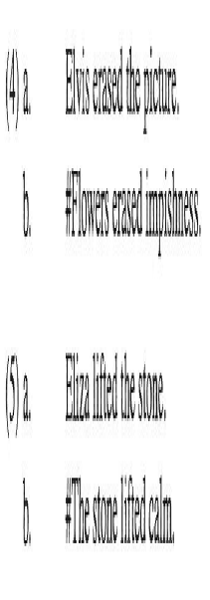
Generalizing about situation types
E.g. #Pictures picked impishness. ➔Semantically anomalous
Limits of semantic categories:
[PICKER]: sth that can move
[PICKED]: a physical entity that can be grasped.
Generalization: ★
A. Physical actions
B. a thing that moves in order to affect another thing. ★
➔ The amount of arguments. (one or two)
Grammatical requirement ≠ semantic requirement
How about “jog” ?
Notes:
Impishness頑皮
Anomalous畸形的 異常的

Slide 8
Relation of verb and its arguments
1 argument (e.g. jog)
[Predicate (argument)]
2 arguments (e.g. pick, erase, lift)
[Predicate (argument1,argument2)]
Notes:
解釋兩個框架意思

Slide 9
Arguments as verb components
Paint = applied paint to = ACTION + THING + DIRECTION
➔Verb paint carries an argument paint
Redundant-examination:
Notes:
目前我們看到句子裡的指涉詞怎麼作為動詞的論元，接著動詞會告訴我們這些指涉詞與動作或狀況的關聯,也就是論元如何構成或補足整個狀況的語意。
有些動詞自己本身意義就包含了的論元在內。

Slide 10
Conceptual Semantic representation of paint:
Conflation:
Apply is similar to paint, but paint is more complex.
Paint incorporates elements other than the predicate itself.
It conflates the argument [THING paint].
Notes:
主要的Predicate是apply 論元包含一個漆東西的、一個油漆、和一個複雜的方向論元
Incorporates 合併

Slide 11
Unexpressed object alternation
Why could the object be unexpressed?
Pragmatic (infer from the context)
Semantic (record in the structure)
★
Notes:
有些詞表面形式像paint一樣，可以省略直接受詞，像是這兩例子，但省略的直接受詞並不像paint這麼明顯。
為什麼可以省略呢？是語用嗎？還是語意？
不是語用，因為兩個原因，一：直接受詞不可以說丟就丟，第二，如果內容可以從語境推敲，那梳頭髮為什麼不能省略。
是語意框架早就決定且記錄誰可以省略而誰不能省。

Slide 12
Summary
Sentence meanings are organized around a main predicating expression, which is usually a verb.
Predicators: tell us sth about the referring expressions in the sentences. (what are they, what are they doing, what’s their relation)
The nature of the predicate determine the kinds of ENTITIES for the arguments.
The number of referring expressions is not necessary equal to the number of arguments. E.g. Paint
Some verbs have complex meaning that conflate some of their arguments. E.g. paint
Some verbs can be involved in grammatical alternations, which can affect their interpretation.

Slide 13
Semantic representation of a verb meaning should include:
A situation type (e.g. physical action, state, mental event)
Indication of how many and what kinds of entities are need and what role they play.
More particular information about what is being predicated of the entities (what kind of event or state)

Slide 14
3. STATES and EVENTS
Whole sentence (Situation) may contain
➔THINGS, ACTIONS, PROPERTIES, a TIME, a PLACE, etc.
Situation:
STATES (stative verb) [static, unchanging] ★
EVENTS (dynamic verb)[happening, changing] ★
How to distinguish stative verb and dynamic verb?
➔By how they relate to time.
STATES: constant across time
EVENT: less so
➔By a question “What happened?” ★
The clock stands in the hall.
The children stood up to greet the teacher
??The clock stands in the hall.
The children stood up.

Slide 15
4. Motion verbs
Motion verbs:
Typical verbs
The meaning could be extended to polysemy and metaphor
Components of a motion verb: ★
Changes in location
Predicate GO
Components of a location verb: ★
NO changes in location
Predicate Be_{loc}
Caution: most verbs are polysemous and its stative or dynamic sense depends on the use in the context.
Sheryl went into town on foot.
Lance cycled across France.
Wilma left.
The monument stands beside the fountain.
Switzerland lies north of Italy.
Notes:
monument 紀念碑

Slide 16
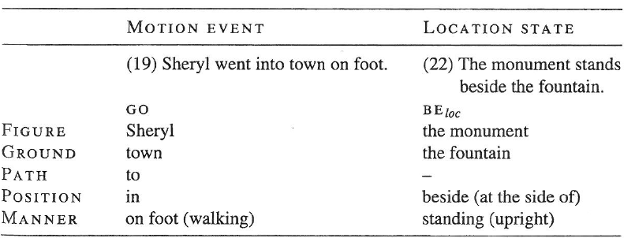
Elements of Situation
Both MOTION and LOCATION include the following elements
Notes:
Figure是被討論的某個事物的位置
Ground又叫座地標(landmark)是指figure被比較的指標物、相對處
Path是指figure過去到GROUND的方向
Position是指最終FIGURE在的位置，相對於GROUND
Manner是指怎麼移動的、怎麼放置的
MOTION部分，manner可省
Location部分，mannter已包含在verb裡面

Slide 17
Conceptual Semantics componential structure
Notes:
MOTION and LOCATION 都首先包含主要謂語be and go,而且都將thing （figure）作為第一個論元。
Location第二個論元是地方，motion第二個論元是path
地方和路徑也有各自的論元結構

Slide 18
Notes:
Manner is optional

Slide 19
Circular GO?
go ➔ GO + THING + PATH
Notes:
GO is not equal to go
大go是基本元素，語意無法在縮減。而小go則是包含了所有資訊（go＋thing＋path）

Slide 20
Examination of redundant elements in verb
Notes:
首先，從LEAVE這詞可以看到GO也是其基本謂語，而和小go的差別在於路徑的不同（包含了FROM PLACE)
接著，測試什麼才是動詞裡的必備論元，就是看加了詞會不會多餘。
加上place不會多餘，所以地方不是內涵在架構內。
像加上path之後就不合和語法，因為他已經內涵在語意架構內。

Slide 21
More about conflation
Cycle conflates MANNER (by bicycle)
Leave conflates PATH
Derail conflates GROUND ★
Most common conflated elements in English verbs:
MANNER and PATH
Languages differ in their preferred patterns of conflation:
Motion verbs in North American languages conflates FIGURE.
Conflated information in not sufficient:★
Notes:
Derail 出軌
蘊含資訊不夠是因為有多加的新資訊在原本的語意上
Emulsion乳膠漆

Slide 22
Another EVENT type: causation
Causation: something caused an EVENT or STATE. ★
Polysemous verb with both causative and non-causative:
Causative alternation★
Notes:
有致使成分的sense語意會多一個論元

Slide 23
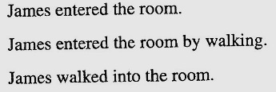
Language typology and polysemy of MOTION verbs
Languages can vary in which pattern of conflation is unmarked- most frequently used.
In English, German, and Chinese: MANNER/CAUSE
E.g. walk, run, roll
PATH-conflating verbs are more rare. E.g. enter ★
In Romance languages, including Spanish: PATH★
Notes:
ENTER和walk誰比較常用？
英文用run一字加上by來說明路徑，但西文卻只需要用paso動詞內涵的路徑，加上副詞corriendo跑著

Slide 24
Extending the Location/Motion structures
Notes:
GO 和 be 都是predicate的常用詞彙，但在不同觀念領域下會有不同的特質，因此雖然句型相同，但是蘊含的語意卻不同。 而went在時間方面的用法又可以用last 替代。（點滑鼠）而且manner verb也可作為place 看待，在譬喻的時候。

Slide 25
5. Non-verb predicates
Are adjectives predicates?
English verb to be is called a copular verb or a linking verb, means that it links a subject to a predicate.
E.g. Charles is giddy.
Giddy (Charles) ➔ Predicate (argument)
Why do we leave out the be-verb?
Chinese does need be-verb and treat giddy/tall as verbs
Arabic need no verb. A pronoun links two nouns.
English needs a verb in every sentence to be grammatical.
Many adjectives denote PROPERTIES.
Notes:
Giddy 輕浮的
形容詞有特質，有特質當然需要有東西來當修飾的對象，也就是論元。

Slide 26
Are adjectives predicates?
Disadvantages of treating adjective as main predicate:
Syntactic structure (in copular languages)
Many adjectives cannot be interpreted without reference to their nouns.
E.g. That roller coaster is really good. (=exciting)
That nap was really good. (=restful)
Relational adjectives:
Express relations between at least tow things.
E.g. Nancy is fond of Paul. Or, Paul is proud of Nancy.
Notes:
如果是謂語，怎麼會被名詞影響，應該是謂語挑論元，而不是論元挑謂語。
姑且不論哪種定調比較好，某些形容詞是一定會被當做謂語看，不會有爭議：這些形容詞表達兩個論元之間的關係。
從結構上可看到，proud擁有一個論元thing，即是某人對另一人感到驕傲的關係

Slide 27
Predicative nouns
Nouns for family relations:
Linda is the mother of the bride.
Other types of relations:
Doj is the president of the Scrabble club.
[_{THING} PRESIDENT ([THING])]
Deverbal nouns:
Stan recited a poem.
Stan’s recitation of the poem.
Caution: some deverbal nouns do not denote EVENTS. ★
Notes:
如果關係算謂語的話，名詞也有表關係的，那名詞也算謂語囉
從結構上來看，當領導人，總要有東西來領導，即論元thing
去動詞化的名詞當然算，因為他和動詞一樣都有一個論元thing
最後提醒，沒有事件指稱的名詞不能算是謂語

Slide 28
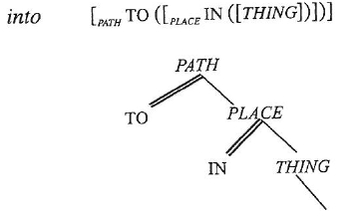
Predication and prepositions
Sheryl went into town on foot.

Slide 29
Most prepositions can be represented as predicates (PATH or PLACE types) that take THING arguments.
Other conceptual fields:
Spatial (e.g. in a room)
Time (e.g. in an hour)
Properties ( e.g. you can get that dress in red)
Caution: Not every preposition is contentful.
Notes:
並非每個pp都有內容，要看CONTEXT
從句法上來看，pp是該片語的頭，後接一個受詞名詞片語，也符合語意的解釋。

Slide 30
Conclusion
4 key concepts related to verb meaning:
Predication
Argument structure
Argument alternation
Conflation
Situation:
EVENT ➔Motion ➔GO, CAUSE
STATE ➔Location ➔BE
Predication of other word classes

